Slide 1
Session 8 11:30 AM 1:30 PM Ministry of Jal Shakti Department of Water Resources, River Development & Ganga Rejuvenation Central Water Commission
Convergence of Government Programme-2
Developing Tourism Attractions and Products
Date: 29-03-2023

Slide 3
*Dams, Reservoirs, Rivers, Lakes and Water Bodies as Tourist attractions Arth Ganga*
Department of Water Resources, River Development & Ganga Rejuvenation
Ministry of Jal Shakti
P S Kutiyal, CE, PPOrg., CENTRAL WATER COMMISSION

Slide 4
***
The Department of Water Resources, River Development and Ganga Rejuvenation, Ministry of Jal Shakti is responsible for laying down policy guidelines and programmes for the development and regulation of country's water resources.
It aims to ensure optimal sustainable development, maintenance of quality and efficient use of water resources to match with the continuously growing demands on this precious natural resource of the country.
Several key policies and schemes are implemented by the department and guidelines issued from time to time to ensure optimal implementation of these schemes and policies at the grass root level.
Several key initiatives achievements and developments have taken place in the department throughout the year 2022, some of which are highlighted below:

Slide 5
***
In 2022, National Mission for Clean Ganga completes 50 projects & sanctions 43 new projects amounting to Rs. 2056 Crore
Prime Minister chairs 2nd National Ganga Council meet on 30th December 2022 via VC in Kolkata
PM inaugurates 7 sewerage infrastructure projects-20 STPs & 612 km network at a cost of more than Rs. 990 crore
PM lays the foundation stone for 5 sewerage infrastructure projects to be developed under NMCG at an estimated cost of Rs. 1,585 crore
Pradhan Mantri Krishi Sinchayee Yojana (PMKSY) for 2021-26 with an outlay of ₹ 93,068 Crore to benefit about 22 lakh farmers
Against target of 34.63 Lakh Ha irrigation potential of 24.35 Lakh Ha (approx. 70.31%) created through AIBP works of the prioritized projects during 2016-17 to 2021-22

Slide 6
***
Ganga Quest 2022 observed active participation of over 1.73 lakh persons from India as well as over 180 countries
National Water Mission launched special campaign – “Catch the Rain” for improving water conservation across the nation
Bureau of Water Use Efficiency (BWUE) set up under administrative control of Department of Water Resources, RD & GR on 20.10.2022 for promotion, regulation and control of efficient use of water in irrigation, industrial and domestic sector
Ken-Betwa Link Project, 1st inter-linking of rivers project being implemented with estimated cost of Rs. 44,605 crore having central support of Rs. 39,317 crores is planned to be completed by March, 2030
Under DRIP Ph-II, co-financed by World Bank and AIIB, inclusion of additional four states namely Karnataka, Uttarakhand, Uttar Pradesh and West Bengal has been notified by the World Bank in June 2022

Slide 7
***
After enactment of landmark Dam Safety Act in December 2021, Union Government constituted National Committee on Dam Safety and established National Dam Safety Authority (NDSA) on 17th February 2022
Since the inception of FMP/RMBA (till March 2022), Central Assistance of Rs. 6686.79 crores released to States/UTs under FMP component of Flood Management & Border Area Programme (FMBAP) scheme and CA of Rs. 1095.16 crores have been released to UTs/States under RMBA component of FMBAP scheme
President of India inaugurated 7th India Water Week 2022 from 1st–5th November 2022 with the theme “Water Security for sustainable Development with Equity”
***

Slide 8
Associated various Offices and schemes are as under:
A. National Mission for Clean Ganga
B. Pradhan Mantri Krishi Sinchayee Yojana (PMKSY)-Accelerated Irrigation Benefit Programme (AIBP)
C. Dam Rehabilitation and Improvement Project (DRIP) Phase II and Phase III
D. Central Water Commission
E. Atal Bhujal Yojana (Atal Jal)
F. Central Ground Water Board
G. National Water Informatics Centre
H. Progress under the scheme “Irrigation Census”
I. Completion of balance works of North Koel Reservoir Project
J. Flood Management and Border Areas Programme (FMBAP)
Date: 11-02-2023

Slide 9
Associated various Offices and schemes are as under:
K. India and Bangladesh Matters
L. National Framework for Sediment Management
M. National River Conservation Directorate
N. Command Area Development & Water Management (CADWM)
O. Central Soil and Materials Research Station (CSMRS)
P. Tungabhadra Board
Q. Jurisdiction of Krishna River Management Board (KRMB) & Godavari River Management Board (GRMB)
R. Surface Minor Irrigation (SMI) and Repair, Renovation and Restoration (RRR) of Water Bodies schemes of PMKSY-HKKP
S. National Hydrology Project
T. National Water Mission
U. National Water Development Agency (NWDA): Ken-Betwa Link Project
V. Dam Safety Act, 2021
***
Date:29.03.2023

Slide 10
Project Implementation Needs
PFR & DPR of MII, MPP, FC&D Projects accepted by Advisory Committee (s) for techno economical viability consideration (benefits envisaged for water uses, cost estimated as per BIS Codes and BC Ratio/ IRR etc.) as per the extent guidelines with statutory clearances as per various Acts applicable to the Projects.
For MPP projects Unit-wise; I-Irrigation HW, II-Canal Network, III-Power, IV-Navigation etc. as well as Abstract-wise A to Q with Direct & Indirect all costs considered with latest SORs.
Projects considered under various schemes are governed by their respective guidelines for eligibility, funding, project implementation, processes (initiation, planning, execution, monitoring & control and Closer/completion) and O&M considerations.
***
Date:29.03.2023

Slide 11
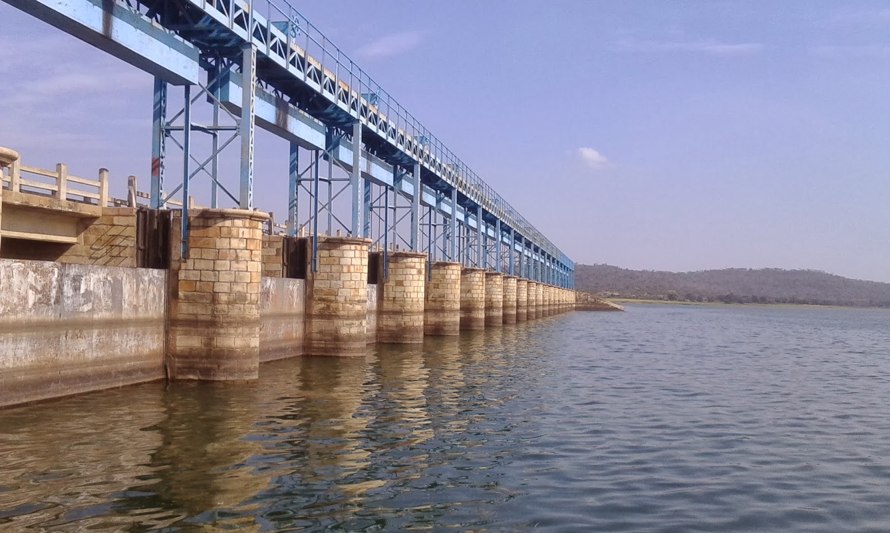
Navgarh_Dam_Varanasi
Techno-economic examination of DPRs of Water resources projects (National & Externally Assisted) and preparation of Note for the Advisory Committee of DoWR, RD & GR on Irrigation, Flood Control and Multipurpose Projects.
Examining Concept Notes of

Slide 12
Shimoga_Dam

Slide 13
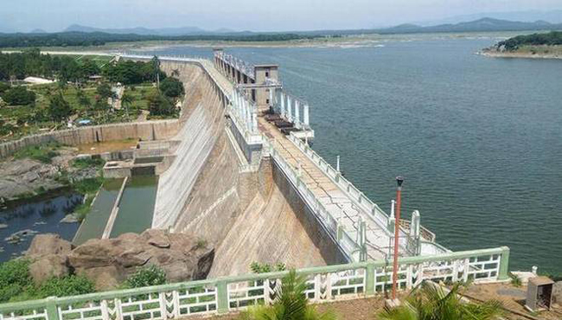
Singreni_Dam

Slide 14
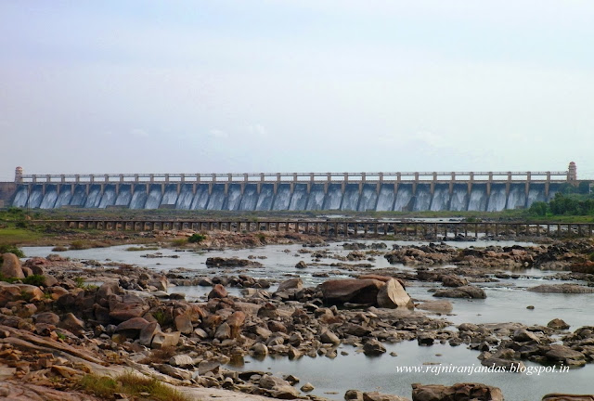
TungaBhadra_Dam

Slide 15
Ganga Aarti - Varanasi

Slide 16
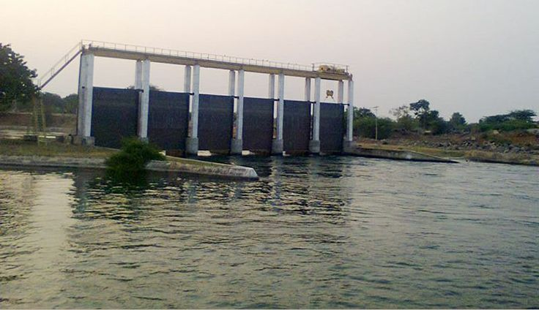
Devaradaddi_

Slide 17
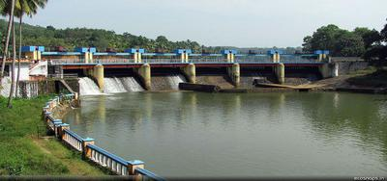
Kosi_Barrage

Slide 18
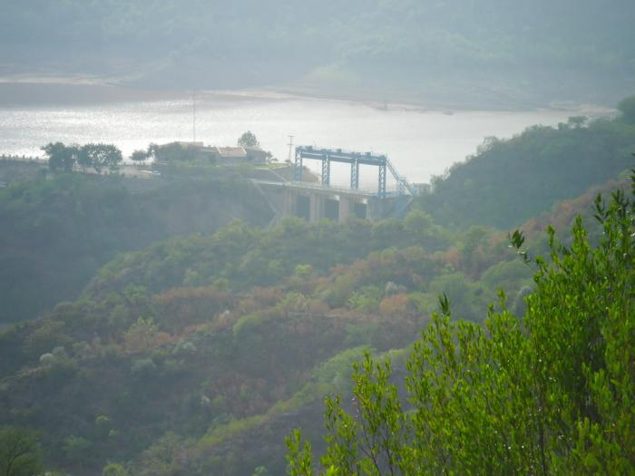
Simly_Dam_and_Guest_House

Slide 19
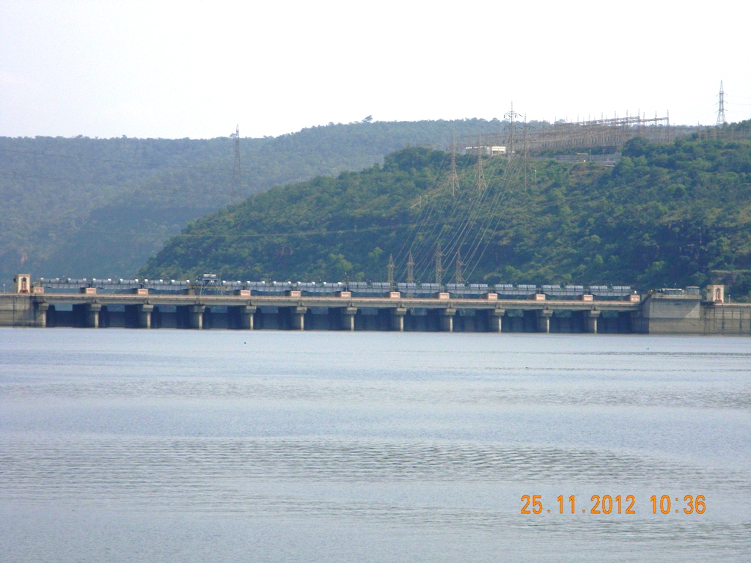
Srisailam_Dam

Slide 20
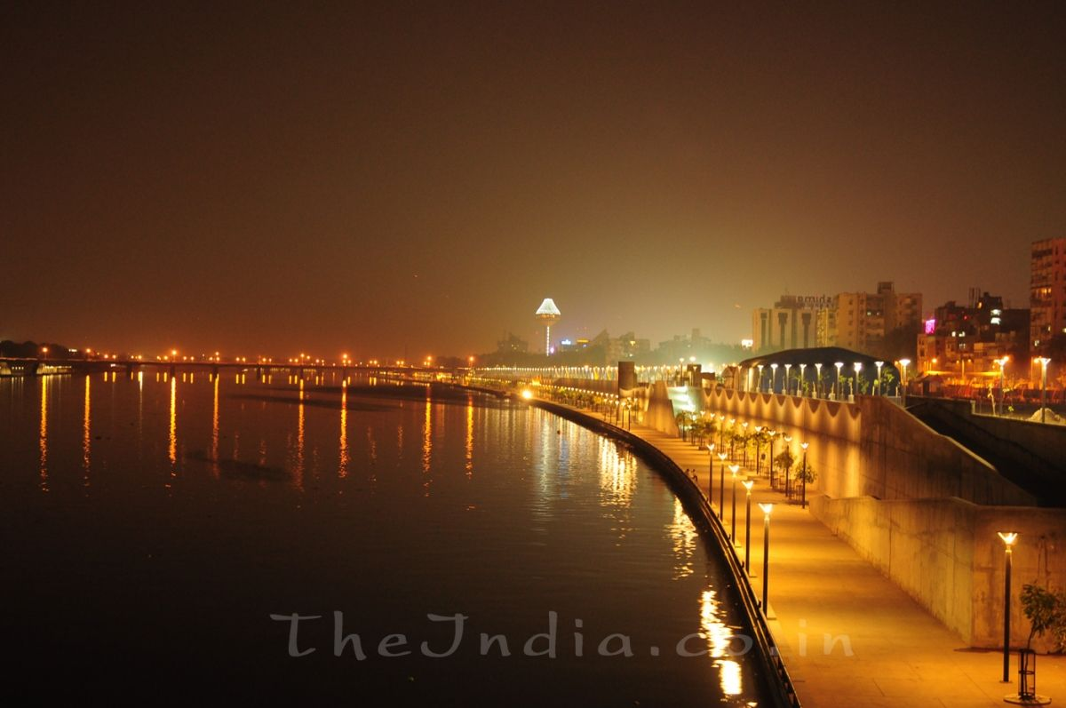
Sabarmati River Front

Slide 21
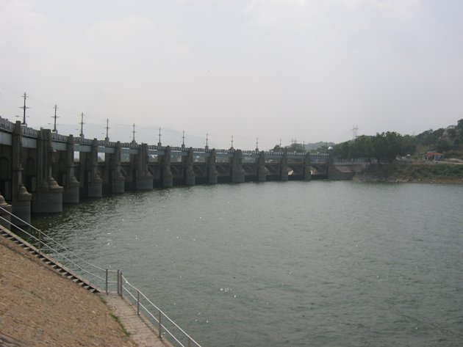
Mettur_Dam

Slide 22
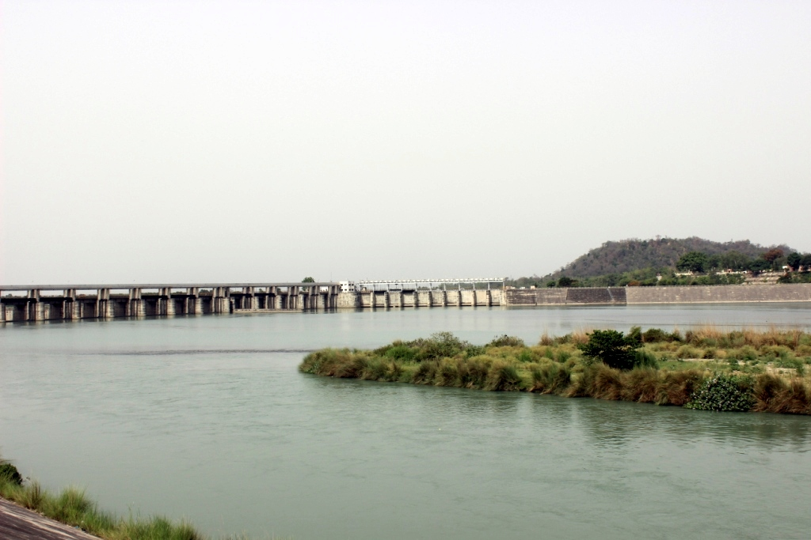
Hathnikund_Barrage

Slide 23
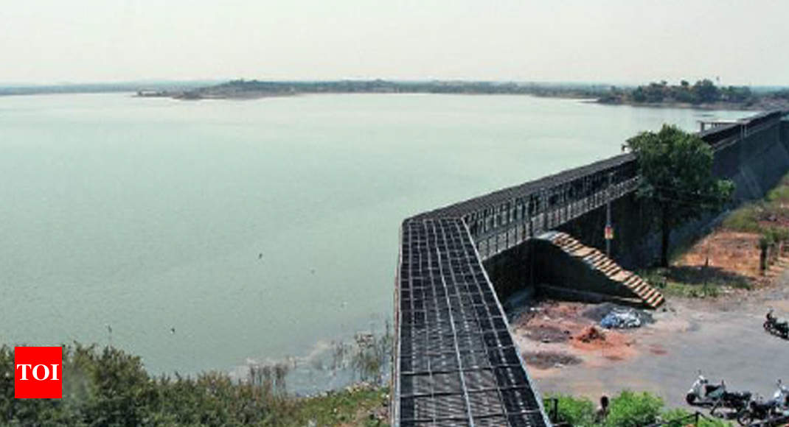
Reservoir_in_Rajkot

Slide 24
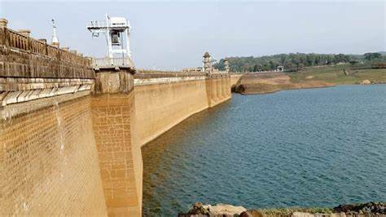
Harangi_Dam

Slide 25
Why Rivers/Dams /Reservoirs/Water Bodies are potential tourist spots
Scenic beauty: Rivers and dam sites are often located in beautiful natural settings, such as mountains, forests, or valleys. The flowing water, lush greenery, and rugged terrain can create stunning vistas that attract visitors.
Recreational activities: Rivers and dam sites provide opportunities for various recreational activities, such as fishing, boating, swimming, and hiking. These activities can be enjoyable for both individuals and families, making them popular tourist attractions.
Cultural significance: Many rivers and dam sites have historical or cultural significance, such as being associated with important events or famous figures. Tourists may be drawn to these sites to learn more about the history and culture of the area.

Slide 26
Benefits of developing Rivers / Dams / Reservoirs / Water Bodies as Tourist Spots
Boost to economy: Developing water bodies as tourist attractions can attract more visitors, which can help boost the local economy by generating revenue for businesses such as hotels, restaurants, and transportation.
Recreational opportunities: Water bodies can provide opportunities for recreational activities such as fishing, boating, swimming, and water sports, which can enhance the quality of life for locals and provide enjoyable experiences for visitors.
Environmental conservation: Developing water bodies as tourist spots can also promote environmental conservation efforts, such as preserving wildlife habitats, monitoring water quality, and promoting responsible use of natural resources.
Cultural heritage preservation: Dams and reservoirs often have cultural and historical significance, and developing them as tourist attractions can help preserve their cultural heritage and promote local traditions.

Slide 27
Important tourist Attractions
Sabarmati River, Ahmedabad - The Sabarmati riverfront in Ahmadabad is a popular tourist attraction, with several parks, gardens, and walkways built along the river.
Ganga River, Varanasi - Varanasi is one of the oldest and holiest cities in India, located on the banks of the Ganga river. The riverfront here is home to the famous Ghats, where pilgrims come to take a holy dip in the river, and tourists can take boat rides and witness the Ganga Aarti ceremony.
Brahmaputra River, Assam - The Brahmaputra river flows through the state of Assam and is home to several wildlife sanctuaries and national parks. The riverfront in Assam is a popular spot for river cruises and water sports, and tourists can also visit the famous Kamakhya Temple, located on the banks of the Brahmaputra.

Slide 28
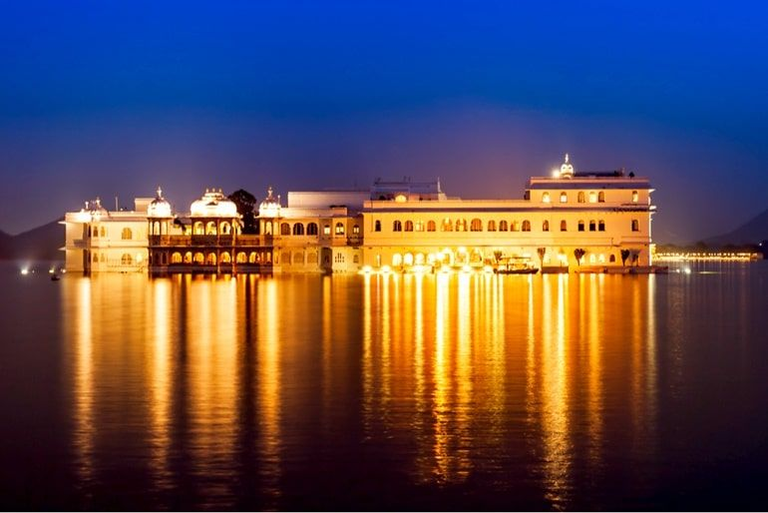
Lake Palace _Pichola Lake Udaipur

Slide 29
Scheme of MoJS Promoting Tourism
Government of India launched a pilot scheme for “Repair, Renovation and Restoration (RRR) of Water Bodies directly linked to Agriculture” during January, 2005.
With the launch of Pradhan Mantri Krishi Sinchayee Yojana (PMKSY) during 2015-16 the scheme of Repair, Renovation and Restoration (RRR) of Water Bodies comes under its fold.
The objective of the scheme includes comprehensive improvement and restoration of water bodies, including protection works to avoid encroachment thereby increasing tank storage capacity. The other key objective is development of tourism, cultural activities, etc.
As per available information, out of 2381 water bodies included under RRR of Water Bodies, 1712 water bodies have been completed till March 2022.

Slide 30
*New concepts were introduced for generating Revenue to TungaBhadra Board (TB) Board*
The following Dashing Cars in vacant place of Garden area of TB Board was established on lease basis for 7 years thus generating a revenue of Rs.127 lakhs.
Amusement Park for Children in Vacant places of Garden area of TB Board was established on lease basis for 7 years thus generating a revenue of Rs.130 lakhs.
Water Park for Children in Vacant places of Garden area of TB Board is established on lease basis for 7 years thus generating a revenue of Rs.76 lakhs.

Slide 31
*New concepts were introduced for generating Revenue to TB Board*
Ropeway for the visitors on PPP model connecting from the Dam Gardens to Vaikunta Guest House was awarded which will generate good revenue to TB Board apart from feast to the Tourists.
BTPS pipe line was allowed all along the boundary of the canal of RBHLC & RBLLC collecting a land lease of Rs. 52.11 Lakhs which is a good revenue to TB Board.
Apart from fetching some revenue, this BTPS pipe line with boundary stones is also acting as a protection to TB Board land from unauthorized encroachments.

Slide 32
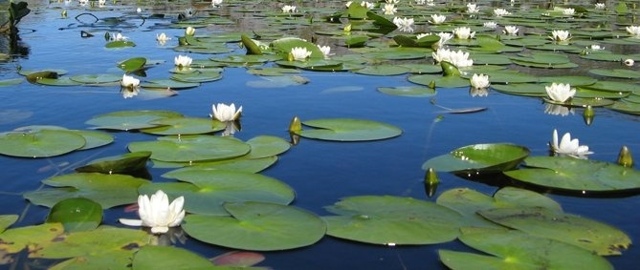
THANK YOU

